Slide 1

OLS (ONLINE LANGUAGE SUPPORT)
ACCESS GUIDE
ANKARA SCIENCE UNIVERSITY
Notes:
Cover translated from the user-supplied Turkish OLS access guide.
[Sources]
OLS Erisim Kilavuzu Surum.pptx — user-supplied source presentation.
[/Sources]

Slide 2
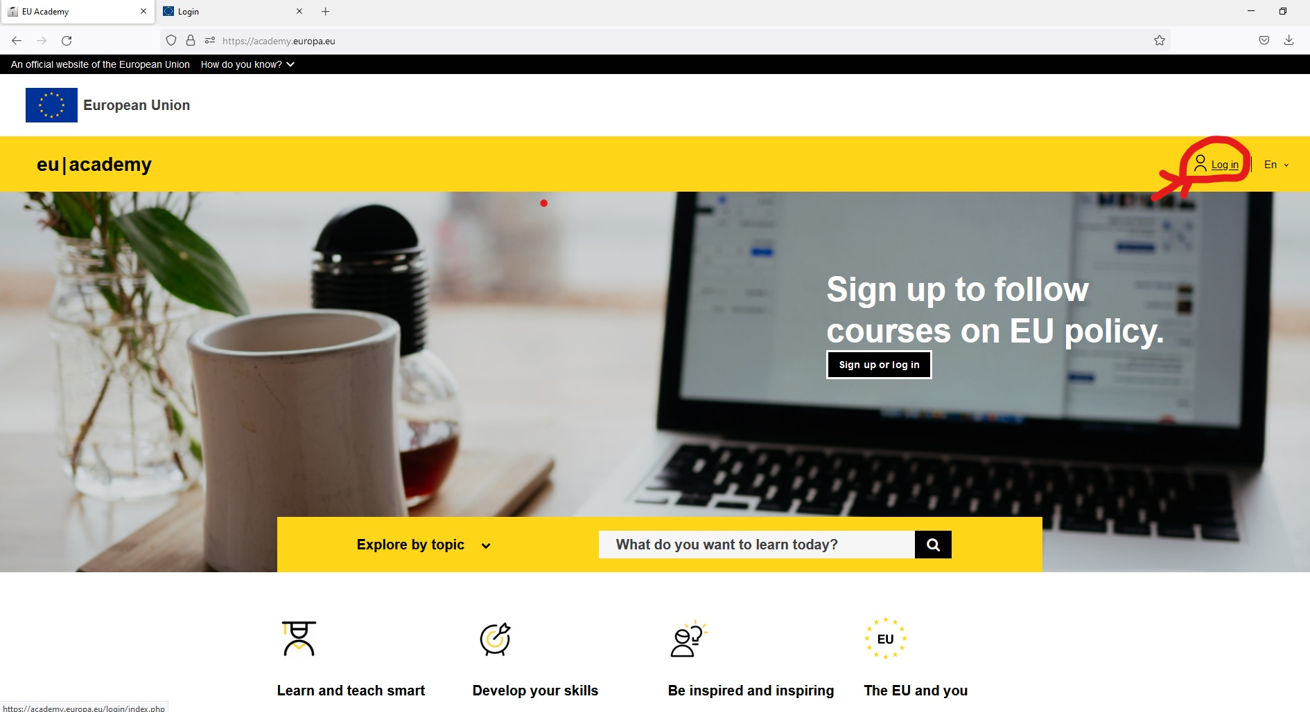
ONLINE LANGUAGE SUPPORT (OLS)
STEP 1
NO. | INSTRUCTIONS
1 | Follow the steps below to take the OLS assessment.
2 | First, create an EU Login account to access EU Academy.
Link | https://academy.europa.eu/
ANKARA SCIENCE UNIVERSITY
Notes:
Step 1 translated from the user-supplied Turkish OLS access guide.
[Sources]
OLS Erisim Kilavuzu Surum.pptx — user-supplied source presentation.
[/Sources]

Slide 3
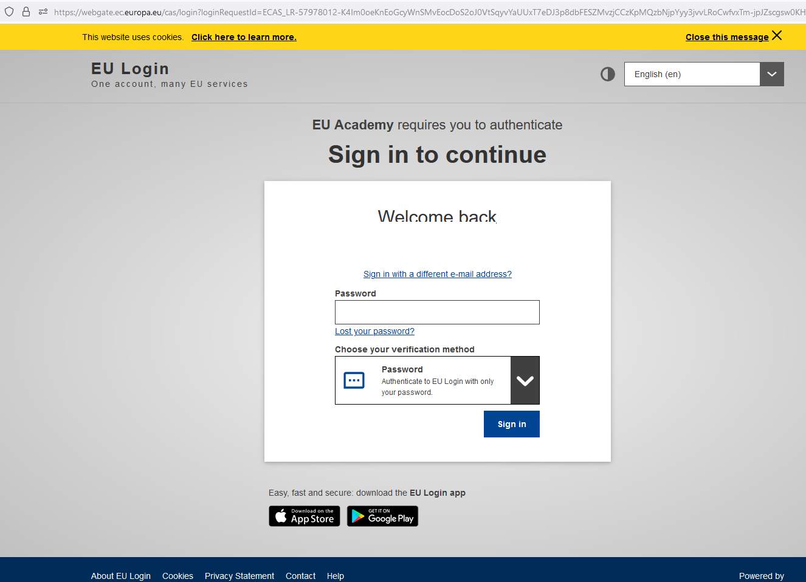
ONLINE LANGUAGE SUPPORT (OLS)
STEP 2
NO. | INSTRUCTIONS
1 | After signing in, use the email you receive to set up your password and account.
2 | Keep your account details in a safe place so you do not lose them.
ANKARA SCIENCE UNIVERSITY
Notes:
Step 2 translated from the user-supplied Turkish OLS access guide.
[Sources]
OLS Erisim Kilavuzu Surum.pptx — user-supplied source presentation.
[/Sources]

Slide 4
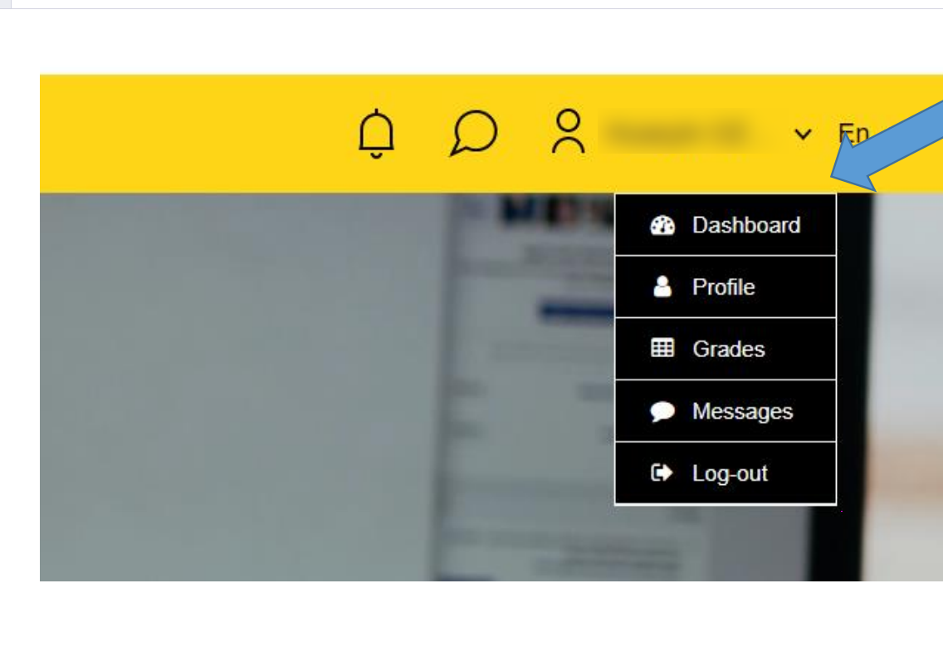
ONLINE LANGUAGE SUPPORT (OLS)
STEP 3
NO. | INSTRUCTIONS
1 | After signing in, open the menu below your name.
 | Select “Dashboard”.
ANKARA SCIENCE UNIVERSITY
Notes:
Step 3 translated from the user-supplied Turkish OLS access guide.
[Sources]
OLS Erisim Kilavuzu Surum.pptx — user-supplied source presentation.
[/Sources]

Slide 5
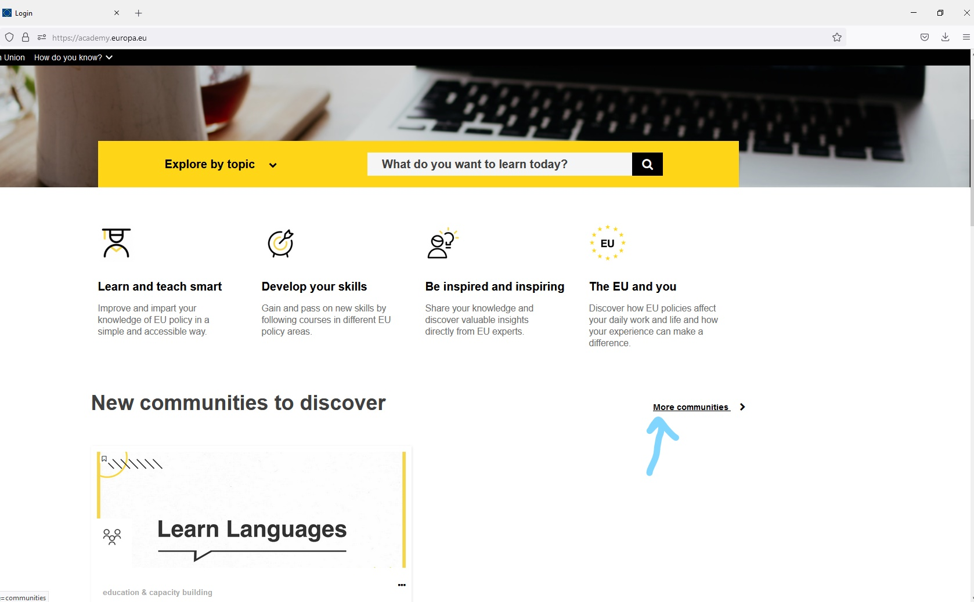
ONLINE LANGUAGE SUPPORT (OLS)
STEP 4
NO. | INSTRUCTIONS
1 | On the page that opens, select “More communities”.
ANKARA SCIENCE UNIVERSITY
Notes:
Step 4 translated from the user-supplied Turkish OLS access guide.
[Sources]
OLS Erisim Kilavuzu Surum.pptx — user-supplied source presentation.
[/Sources]

Slide 6
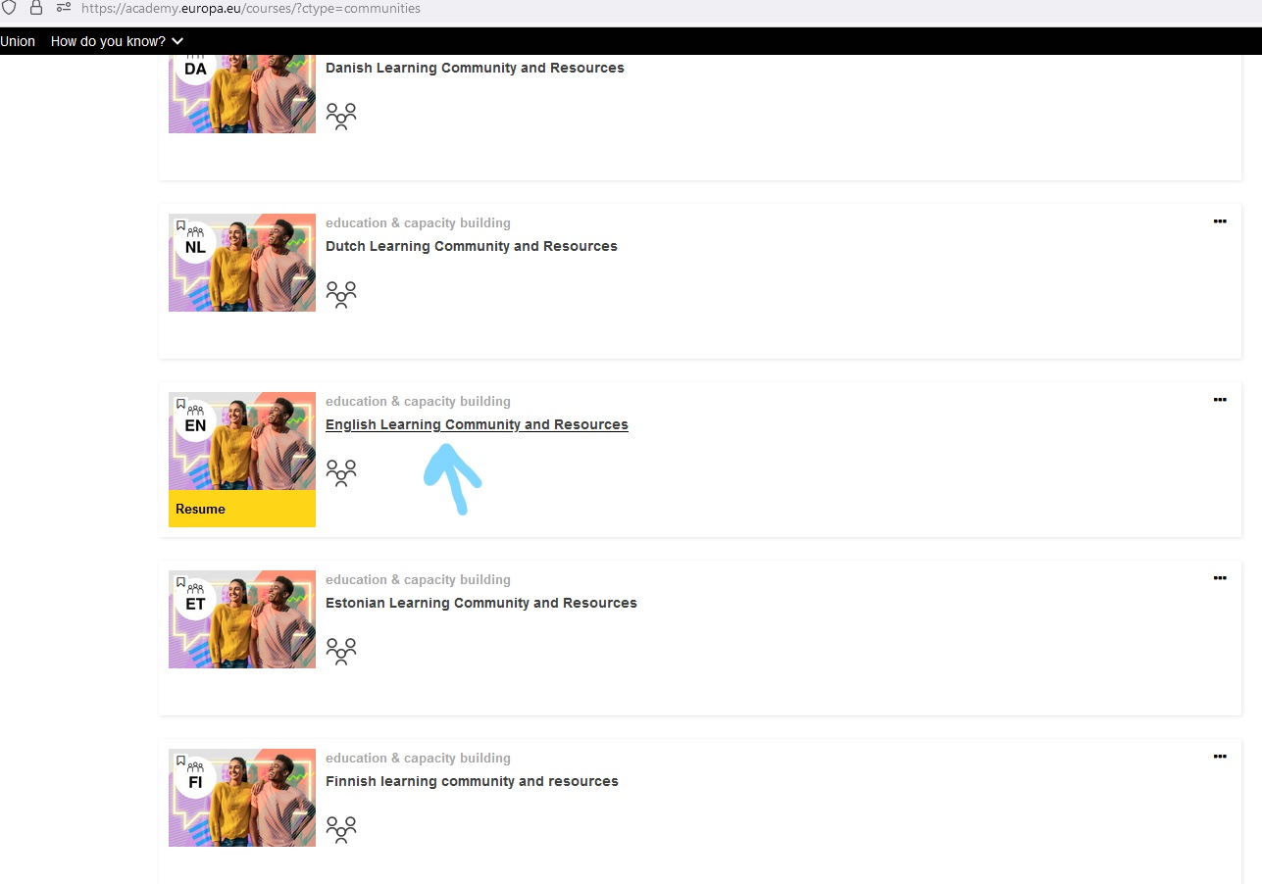
ONLINE LANGUAGE SUPPORT (OLS)
STEP 5
NO. | INSTRUCTIONS
1 | Open the “English Learning Community and Resources” link.
ANKARA SCIENCE UNIVERSITY
Notes:
Step 5 translated from the user-supplied Turkish OLS access guide.
[Sources]
OLS Erisim Kilavuzu Surum.pptx — user-supplied source presentation.
[/Sources]

Slide 7
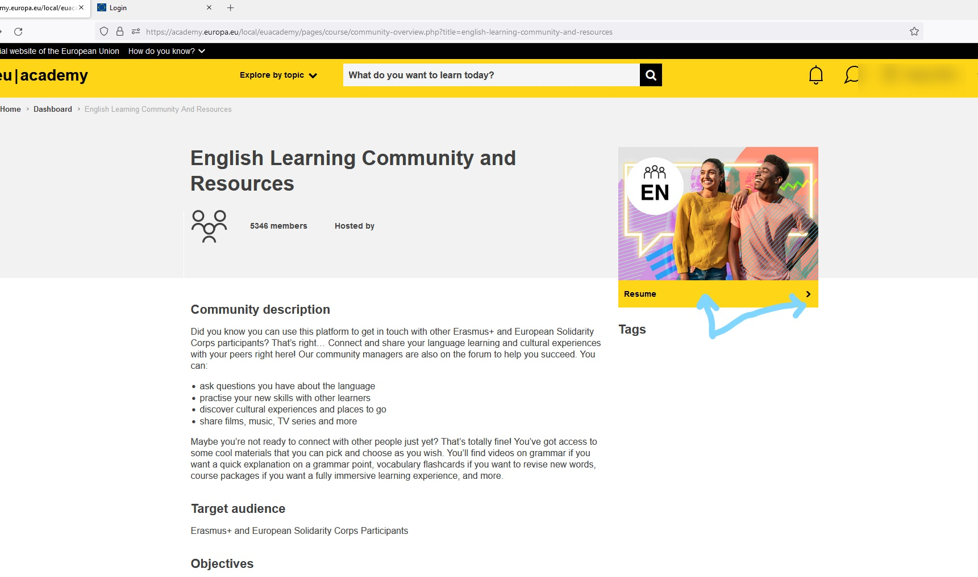
ONLINE LANGUAGE SUPPORT (OLS)
STEP 6
NO. | INSTRUCTIONS
1 | Move the cursor over the image and click the “Resume” arrow.
ANKARA SCIENCE UNIVERSITY
Notes:
Step 6 translated from the user-supplied Turkish OLS access guide.
[Sources]
OLS Erisim Kilavuzu Surum.pptx — user-supplied source presentation.
[/Sources]

Slide 8
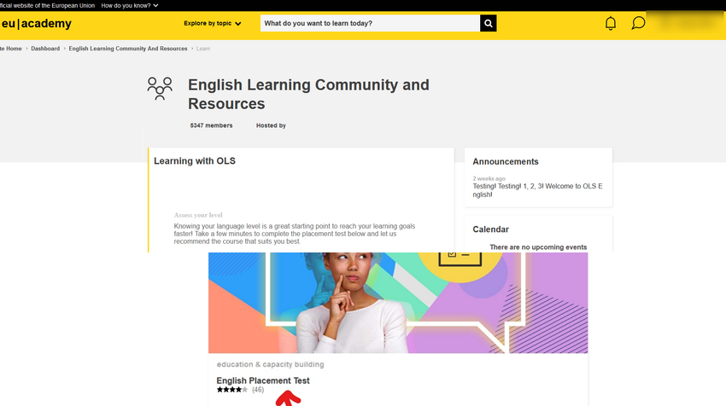
ONLINE LANGUAGE SUPPORT (OLS)
STEP 7
NO. | INSTRUCTIONS
1 | Scroll to the bottom of the page and open “English Placement Test”.
ANKARA SCIENCE UNIVERSITY
Notes:
Step 7 translated from the user-supplied Turkish OLS access guide.
[Sources]
OLS Erisim Kilavuzu Surum.pptx — user-supplied source presentation.
[/Sources]

Slide 9
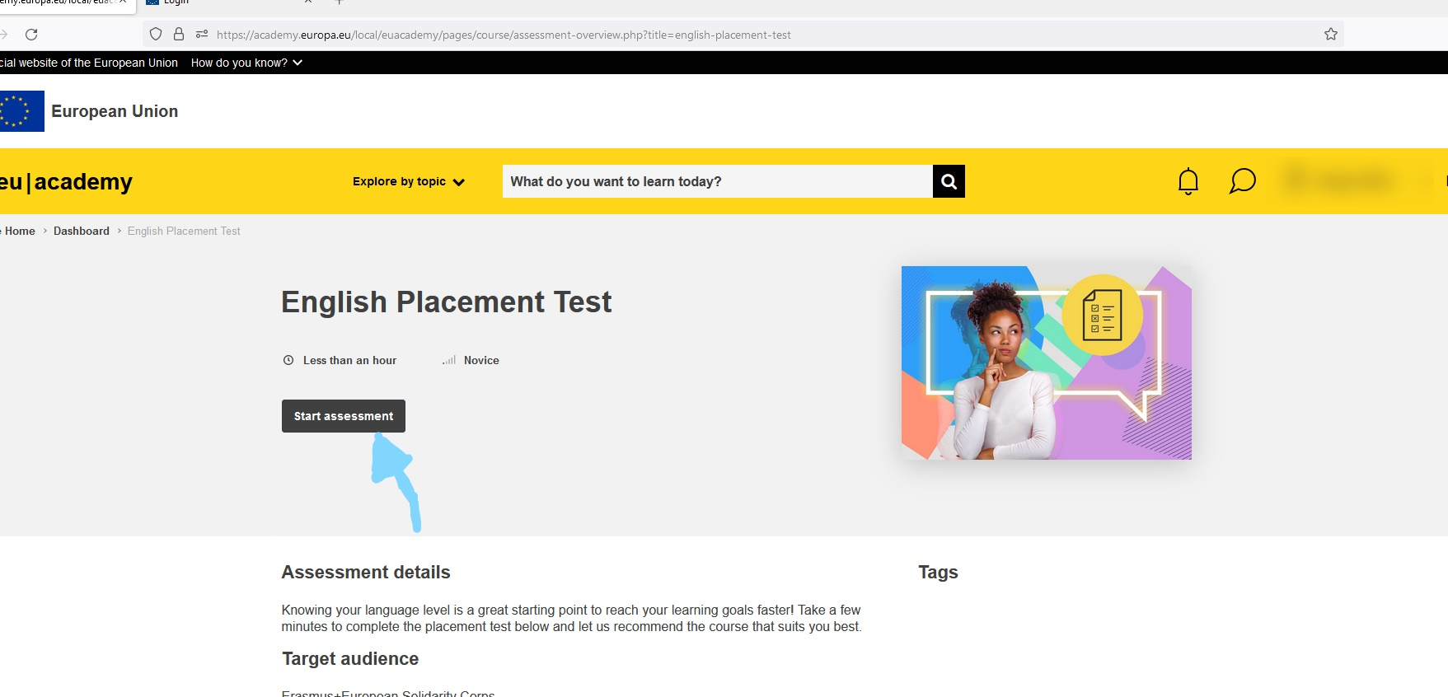
ONLINE LANGUAGE SUPPORT (OLS)
STEP 8
NO. | INSTRUCTIONS
1 | Click “Start Assessment” to begin the test.
ANKARA SCIENCE UNIVERSITY
Notes:
Step 8 translated from the user-supplied Turkish OLS access guide.
[Sources]
OLS Erisim Kilavuzu Surum.pptx — user-supplied source presentation.
[/Sources]

Slide 10

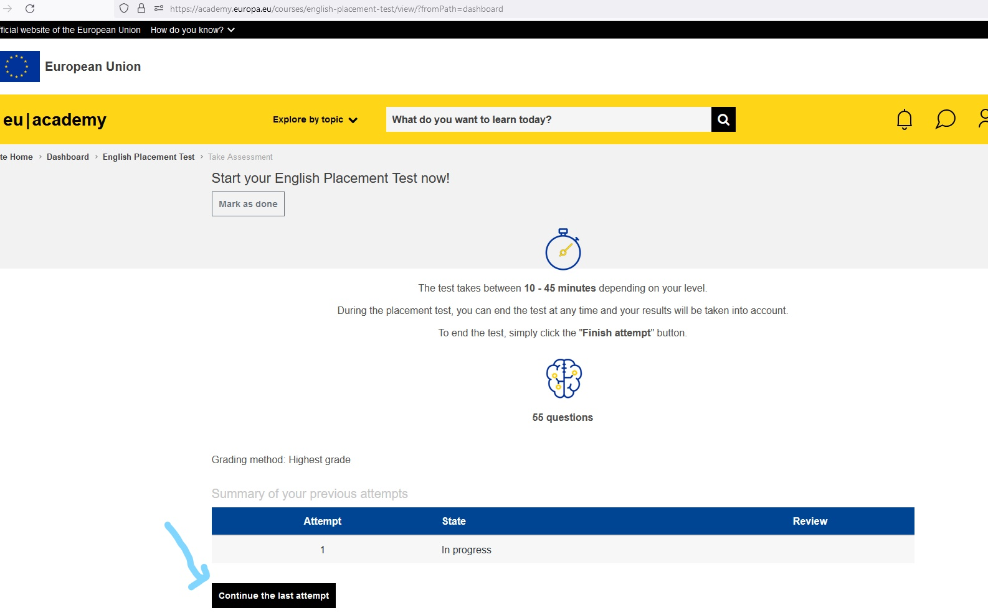
ONLINE LANGUAGE SUPPORT (OLS)
STEP 9
NO. | INSTRUCTIONS
1 | The test takes 55 minutes and assesses reading comprehension, vocabulary, gap filling, grammar and listening skills.
ANKARA SCIENCE UNIVERSITY
Notes:
Step 9 translated from the user-supplied Turkish OLS access guide.
[Sources]
OLS Erisim Kilavuzu Surum.pptx — user-supplied source presentation.
[/Sources]

Slide 11
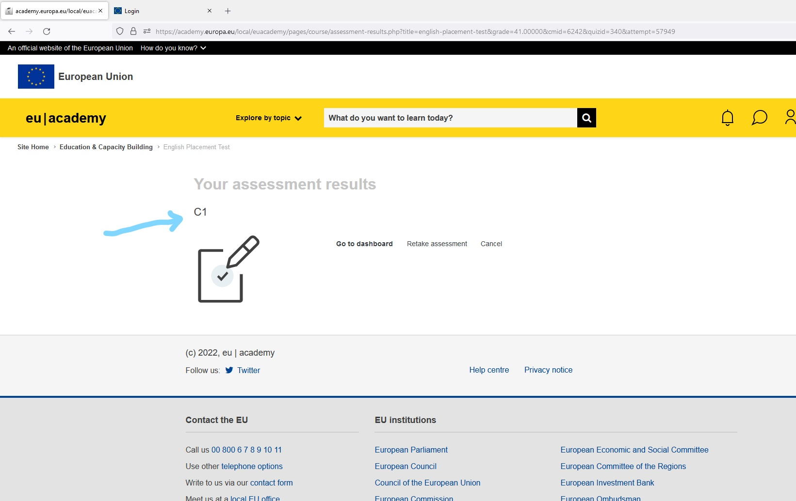
ONLINE LANGUAGE SUPPORT (OLS)
STEP 10
NO. | INSTRUCTIONS
1 | Take a screenshot of your result with your name visible and email it to the Erasmus Coordination Office.
2 | Please complete the assessment carefully, as departure payments cannot be processed without your test result.
 | We wish you every success.
ANKARA SCIENCE UNIVERSITY
Notes:
Step 10 translated from the user-supplied Turkish OLS access guide.
[Sources]
OLS Erisim Kilavuzu Surum.pptx — user-supplied source presentation.
[/Sources]

Slide 12
ERASMUS COORDİNATİON OFFİCE
erasmus@ankarabilim.edu.tr
ANKARA SCIENCE UNIVERSITY
Notes:
Cover translated from the user-supplied Turkish OLS access guide.
[Sources]
OLS Erisim Kilavuzu Surum.pptx — user-supplied source presentation.
[/Sources]

